Slide 1
Basics of Spreadsheets

Slide 2
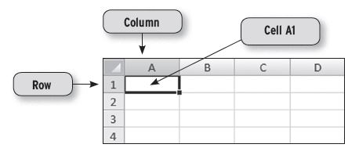
What is a Spreadsheet?
A Spreadsheet is a multi-column, multi-row matrix which enables users to input, manipulate and process numeric data.
A Spreadsheet is made up of many cells.
Cells can contain:
• Labels
• Values
• Formulae
• Functions

Slide 3
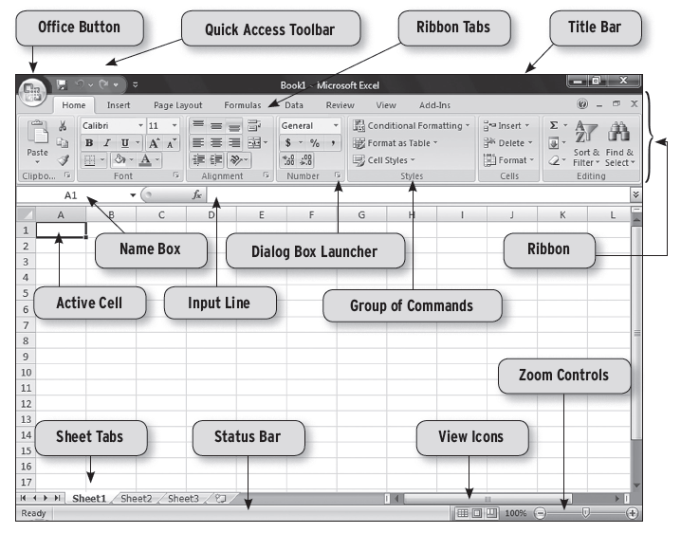
The Excel Environment

Slide 4
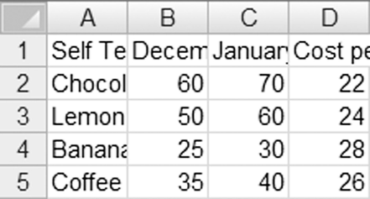
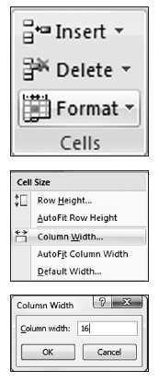
Column-Width Formatting
• Place the cursor anywhere in column A.
• Left-click on the Format dropdown button
(‘Home’ Ribbon » ‘Cells’ Group).
• From the dropdown menu,
left-click on the Column Width button.
• Enter a larger width.

Slide 5
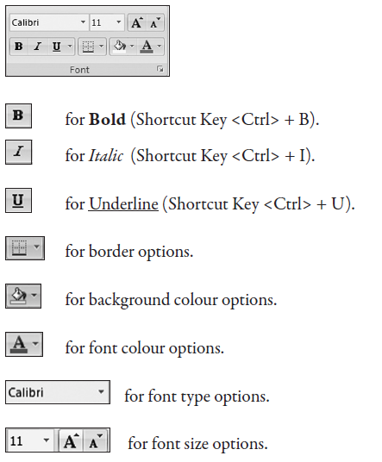
Cell Formatting
Formatting a worksheet helps to enhance its look and make it easier to read.
The most common formatting functions are found on the Font Group which is located on the Home Ribbon:

Slide 6
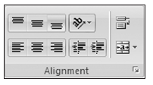

Justification of Cell Data
Excel allows you to modify the alignment of entries in individual cells for both
numbers and text by clicking on any of the icons shown adjacent:
Left alignment.
Centre alignment.
Right alignment.
Centre & Merge across multiple columns. For example, to centre and merge
the entry across columns A to C.

Slide 7

Currency and Percentage Displays
Highlight the cell or range of cells that needs to be formatted as currency or percentage.
Left-click the relevant icon:

Slide 8

Controlling the Number of Decimal Places
Highlight the data that needs to be adjusted. Control the number of decimal places with this icon:
(‘Home’ Ribbon »’Number’ group).
The Left icon is used to increase the number of decimal places while the Right icon is
used to decrease the number of decimal places.

Slide 9
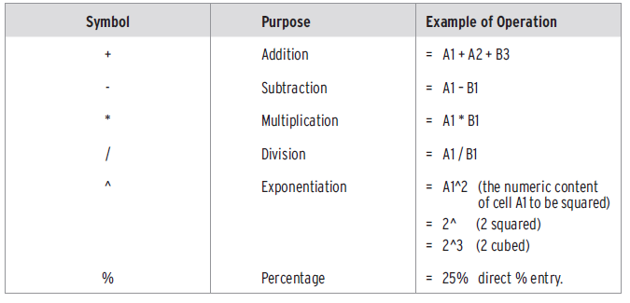
Spreadsheet Arithmetic Operation

Slide 10
Spreadsheet Formulae
The power of a spreadsheet comes from its ability to process user-created formulae based on the relationships between its many worksheet cells.

Slide 11
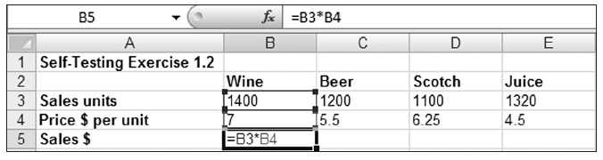
Example
The steps involved in the entry of the formula in cell B5 are:
• Place the cursor in cell B5 and press the = (equal key) to make cell B5 the activecell.
Note: cell B5 is where the answer is to appear.
• Using either the <Up Arrow> key or the mouse pointer, move the cursor to cell B3 and press the multiplication symbol (*).
• Using the <Down Arrow> key or mouse pointer, move the cursor to cell B4.
• Press the <Enter> key to signify the end of the formula entry. At this point the answer 9800 will be displayed in cell B5.

Slide 12
Spreadsheet Functions
Excel has a number of in-built functions that facilitate the analysis of data.
Functions can be used within formulae or can be used alone.
Functions are always prefixed by an “=” (equal) sign.

Slide 13
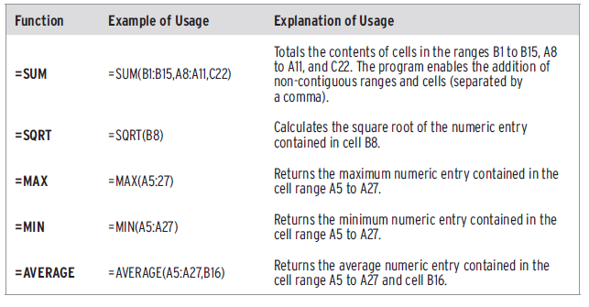
Spreadsheet Functions

Slide 14
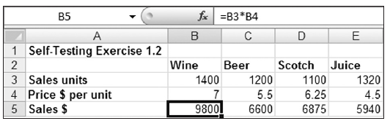
Display of Formulae and Functions
Method 1: This method only applies to the current cell.
Move the cursor to the cell containing the formula entry.
The formula contained in that cell will be displayed on the input line and at the cursor location.

Slide 15
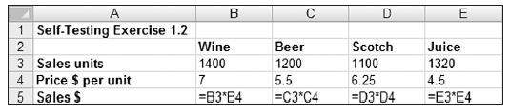
Display of Formulae and Functions
Method 2: This method apples to the entire worksheet.
Press <Ctrl> + <~> (the Tilde key “~” is located above the <Tab> key). The screen
should appear as shown below:
Press <Ctrl> + ~ again to revert back to the default display.

Slide 16
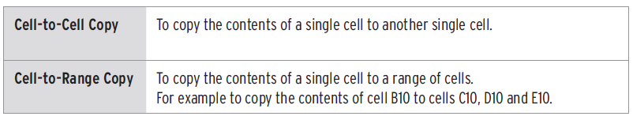
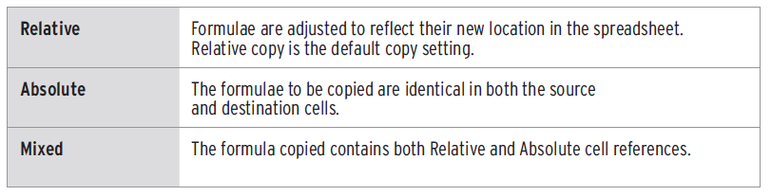
The Copy Commands
When copying formulae it is possible to specify whether the formulae to be copied will be:

Slide 17
Cell-to-Cell Copy
Place the cursor over a cell
Left click the copy button (<Ctrl> + C as a shortcut)
Move the cursor over another cell and press <Enter> (<Ctrl> + V)

Slide 18
Cell-to-Range Copy
Place the cursor over a cell
Left click the copy button (<Ctrl> + C)
Move to another cell and select a range of cells by holding <Shift> and using the right arrow or mouse.
The cell to be copied will have a dash border while the cell range to receive a copy will be in bold.
Press <Enter> to paste.

Slide 19

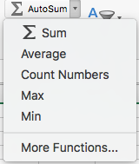
The Autosum Function – this is a great tool
Select a range of cells
Left click the Autosum button and press <Enter>
Excel will automatically add up the numbers in the rows and the model will appear as shown below.

Slide 20
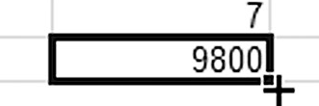
The Fill Handle – also a very handy tool
An alternative way of copying cells is to use the Fill Handle.
The Fill Handle appears as a small black cross displayed at the bottom right corner of the selected cell.

Slide 21
The Fill Handle
Select a cell. There should be a black square in the bottom right of the cell.
Place the mouse over the square. The square should now become a black cross.
Left click, hold and drag the mouse to select a range of cells.
Release the mouse button to copy the formula into other cells very quickly.

Slide 22
Absolute Copy Procedures
The use of the Absolute copy facility enables the locking of a single cell, row, or column into a formula, so that when the formula is copied the original cell reference will be maintained.

Slide 23
Absolute Copy Procedures
To make an entry absolute, press <F4> (function key F4) as follows:
• Once To make the cell reference absolute, for example $A$5.
• Twice To make the entire row absolute, for example A$5.
• Three Times To make the entire column absolute, for example $A5.
• Four Times To cancel all absolute references and reset the cell reference, e.g. A5.

Slide 24
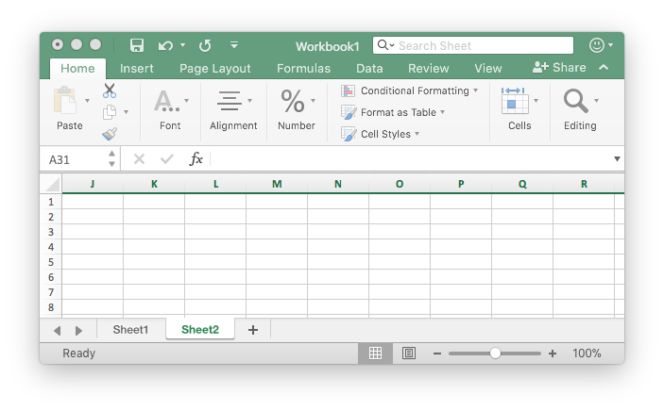
For the Accounting assignment
You need to link cells in different worksheets
See sheet 1 and sheet 2.
These can be renamed as Journal or ledger

Slide 25
Then we can link data in one sheet (journals) with a cells in another sheet (ledgers)
How? Use the “=“ sign in the cell you want to put the data then go and find the data in the relevant sheet and hit enter…so easy…try it

